Slide 1


BIA - 660
Web Mining

Slide 2
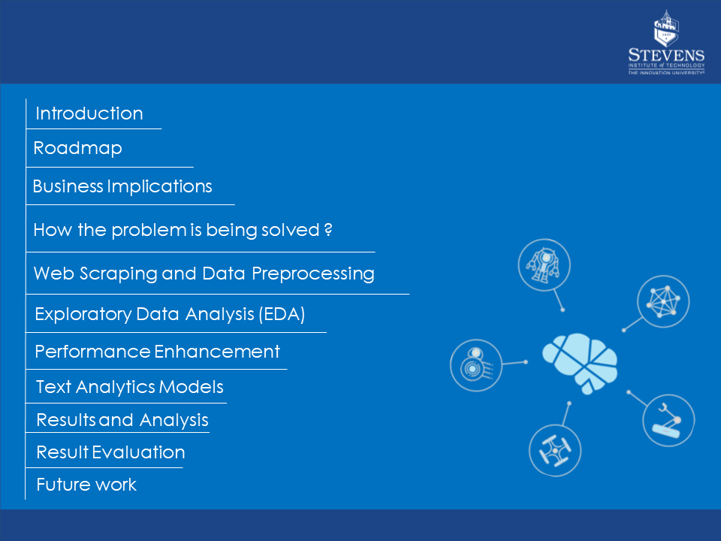
Contents
Amey

Slide 3
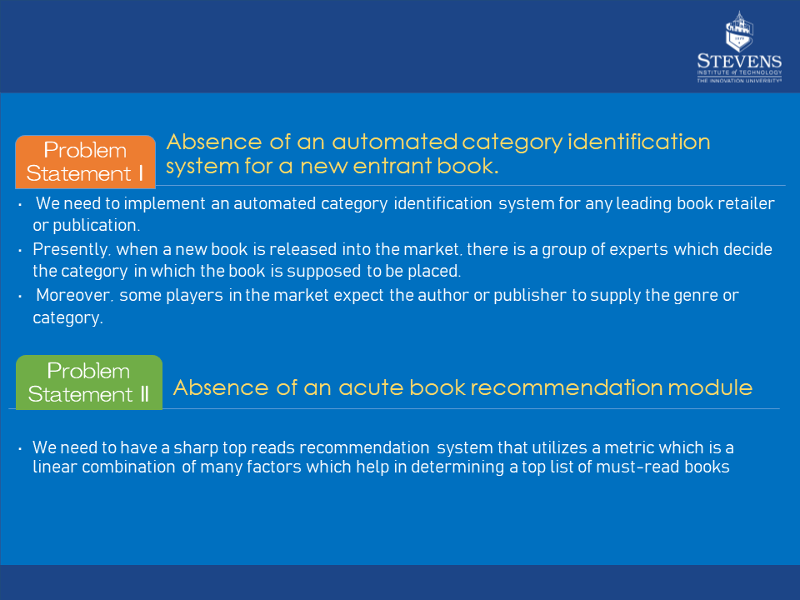
Problem Statement & Shortcomings
Introduction
Amey

Slide 4

Objective
Introduction
The following are the principal objectives of the project concept :
When a new book comes into the market we can determine and place the book in which category it should best fit to be a bestseller.
When a user visits goodreads he will be furnished with significant recommendations and top reads.
Harnessing the polarity, subjectivity, compound, negative, netural, positive factors and most importantly the emotion of the book.
Providing the customers of goodreads with a superior and enhanced user experience through serving them with the best quality literature.
Establishing a complete book recommendation system.
Amey

Slide 5

What is ?
Introduction
Goodreads was founded by Otis Chandler in January 2007.
Goodreads is the world's largest site for readers and book recommendations. Their mission is to help people find and share books they love.
Goodreads can be used to track your reading and communicate with other readers, not a source for books. To read a book, you can buy a physical copy, borrow from your library, buy or borrow an ebook, or buy or borrow an audiobook. After you read it, get on Goodreads to update and discuss it.
Goodreads conducts a yearly award program, first launched on Goodreads in 2009. Users can vote for the books that Goodreads has nominated and are also able to nominate books of their choosing, released in the given year
Amey

Slide 6
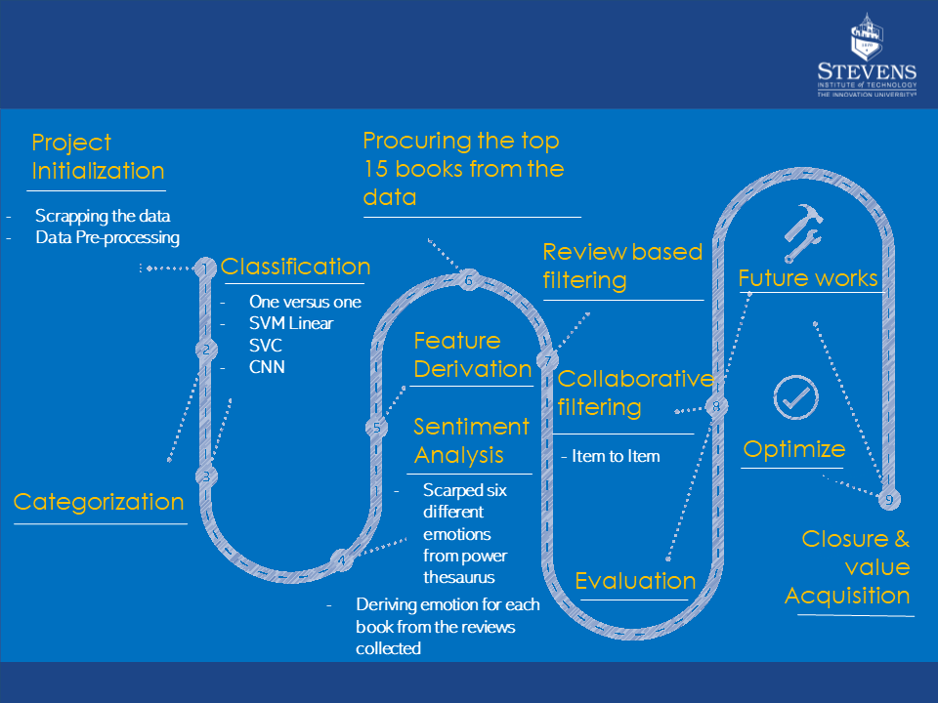
Project Roadmap
Amey

Slide 7
Business Implication
The following are the business propositions and values that the project brings to enhance business :
Ability to generate top reads and provide recommendations for users of goodreads
Seamless assignment of a new entrant book into the desired category.
This brings the following value to the business:
Attracts new customers by providing what they are looking for.
Reduces search and surf time of customers. This is an important factor as when it comes to the e-commerce business segment, the major user base loss is due to loss of interest of users because of ambiguity in generating required outcomes.
This brings the following value to the business:
Opportunity for business alliances with publishers and authors that helps in forming collaborative business elements thereby increasing the market value of goodreads amongst readers .
Requirement of experts which help in deciding in which category the book needs to be placed is eliminated due to the automated process.
The ability to bring out the emotion of the books proves to be a technological breakthrough that will help as a promoting element in driving the business further.
Have a competitive edge to goodreads in the market based on their sharp focus towards delivering better usability for the customers
3)
4)
Amey

Slide 8
How the problem is being solved ?
Vignesh

Slide 9
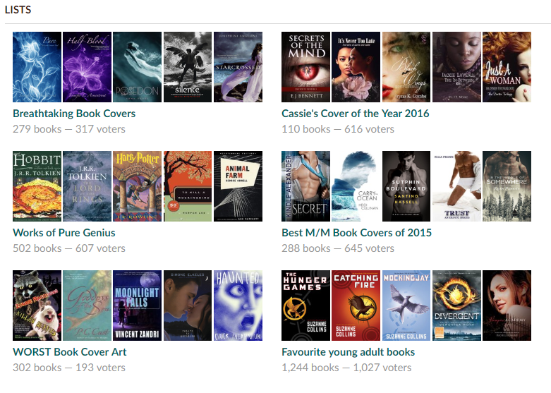
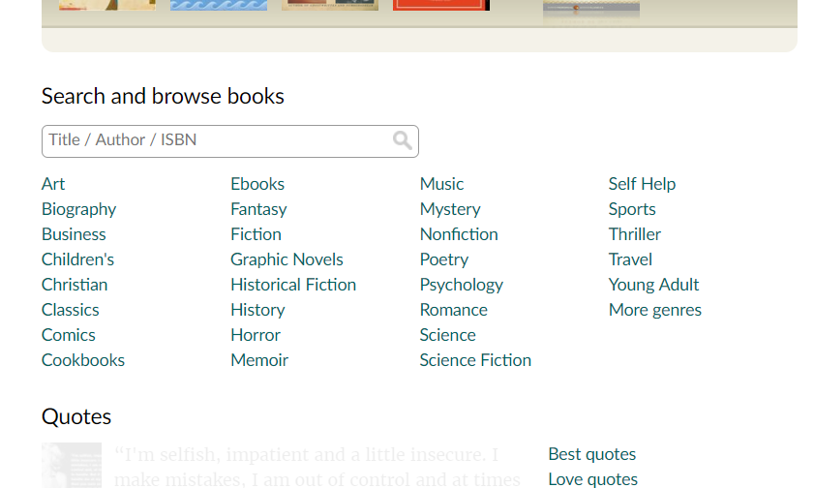
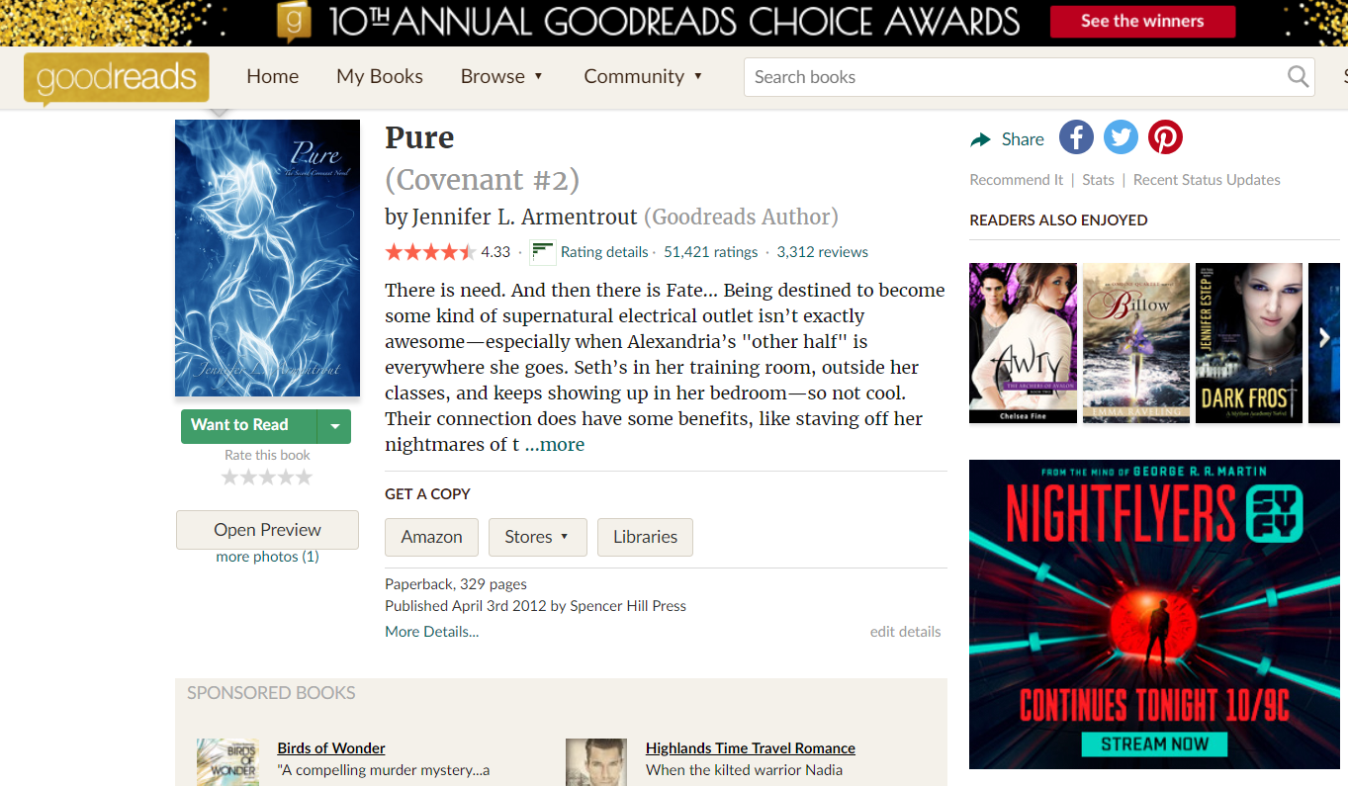
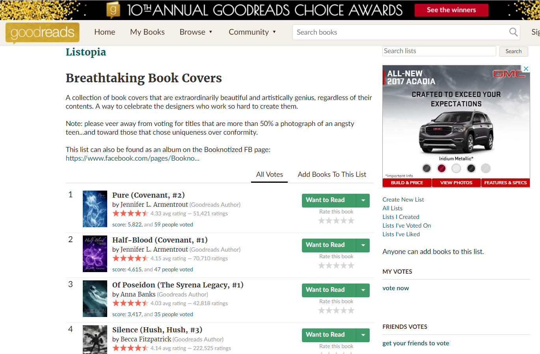
Web Scraping
The following is the sequence of steps that was involved in scraping the data from Goodreads:
Initially we are scraping the 27 categories that are available on Goodreads.
Each category is then explored to scrap the first 300 books.
This includes the Category, names, links and scores.
The name, author, author profile, awards, description, and ratings of each book is extracted.
The list of books in each category is stored in a csv file along with the corresponding details.
Vignesh

Slide 10
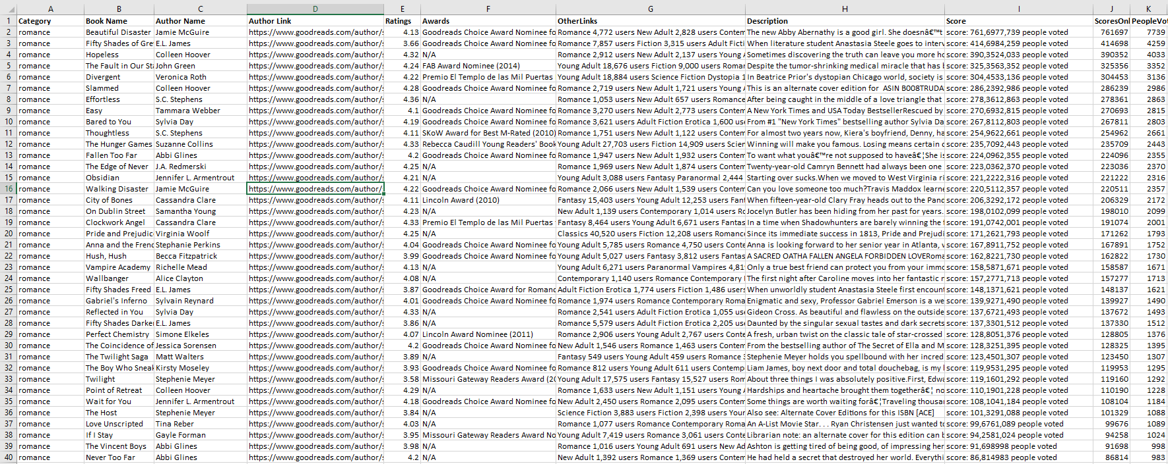
Data Preprocessing
Category
Category, reviews, users and description
8700 records were scraped
300 book per category was scraped
A total of 17 categories
Vignesh
Notes:
Treated null values
translated the texts from other languages using TextBlob

Slide 11
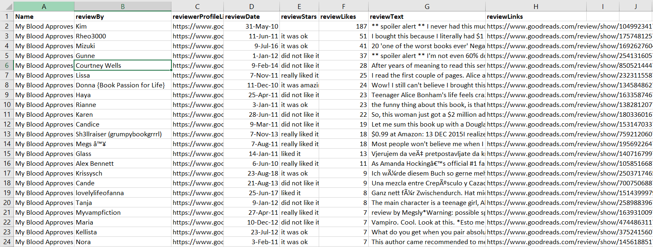
Data Preprocessing
The important features of each book such as the reviews, reviewedby, reviewedprofile and likes are stored in a csv file for 300 books in each category .
Name of the book
Reviewer
profile
Text extraction to obtain the reviews of all the books
Vignesh

Slide 12
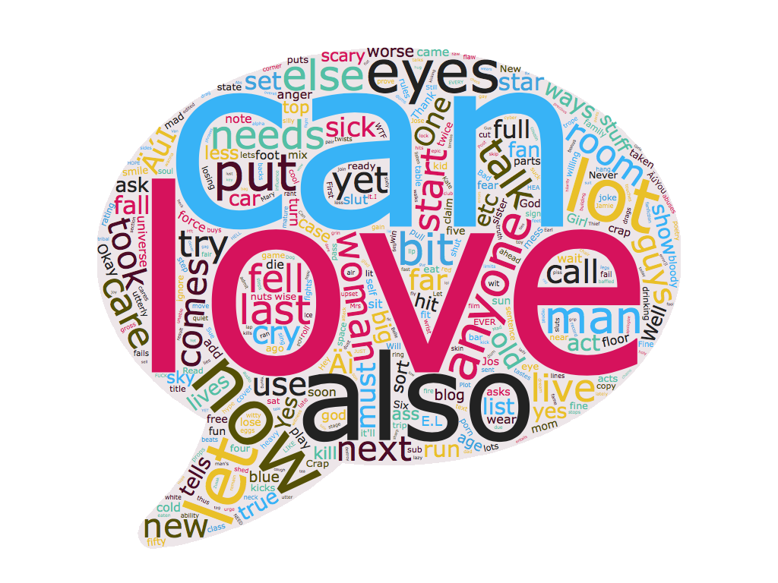
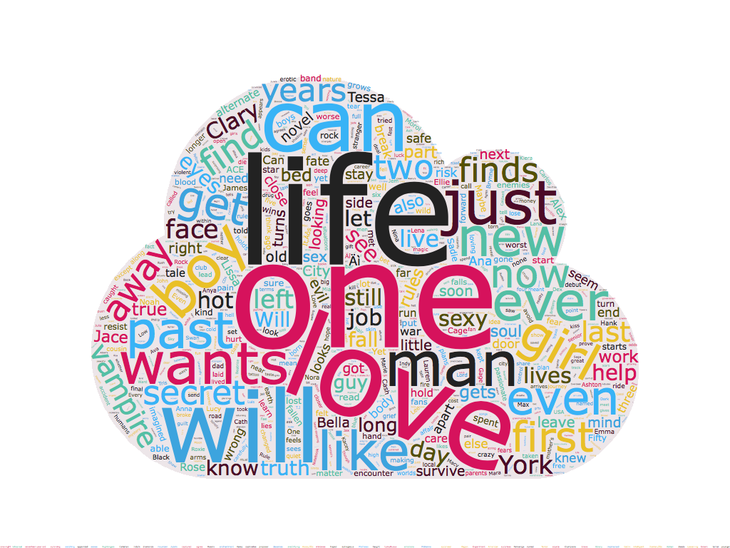
Wordcloud
Word cloud for reviews
Word cloud for book description
Vignesh

Slide 13
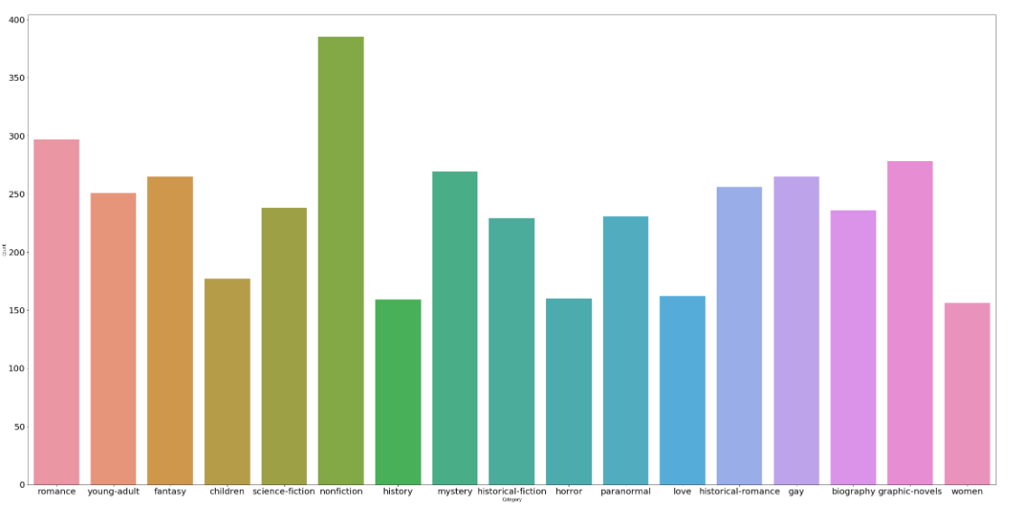
Exploratory Data Analysis
We tried to understand the distribution of the books among the predefined
17 categories that was scraped from Goodreads.
Vignesh

Slide 14
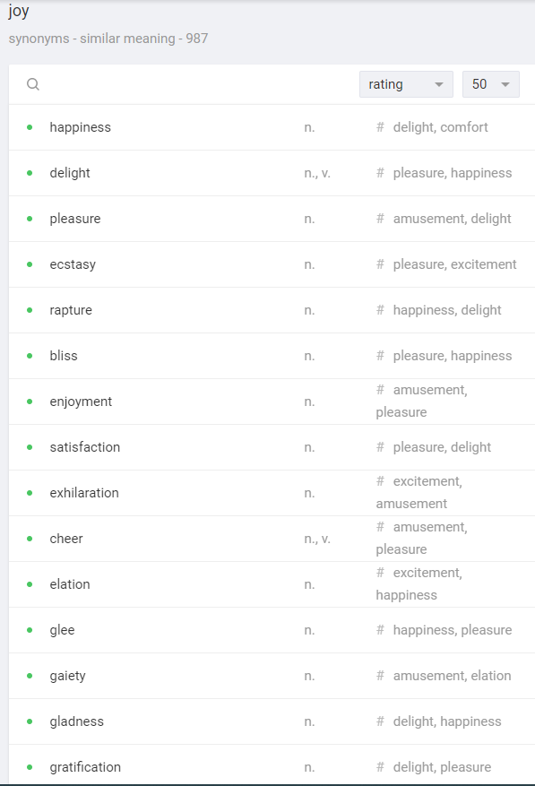
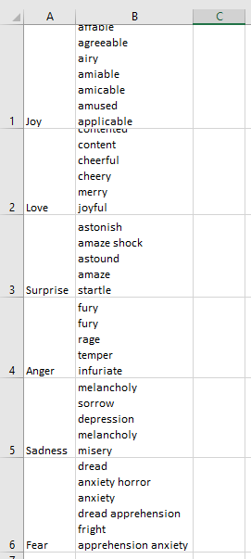
Emotions
We categorized the wide range of emotions into a subset of 6 core emotions.
Love, surprise, anger, happy, sadness and fear.
We used https://www.powerthesaurus.org to
scrape a list of 500 unique keywords for each emotion.
We tried to maintain a list of unique words for each category at the same time keeping each list with the same number of keywords.
We used the CountVectorizer to get the word
count and divided it by the total number of
words of the reviews for a single book.
(Term Frequency) (Normalized)
Shraddha

Slide 15
Deriving the features from the scraped data
Shraddha

Slide 16
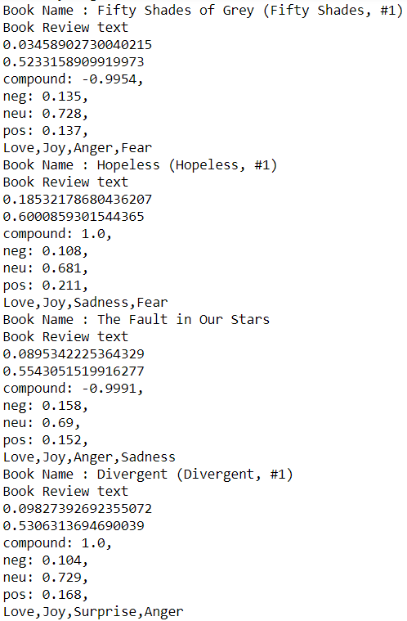
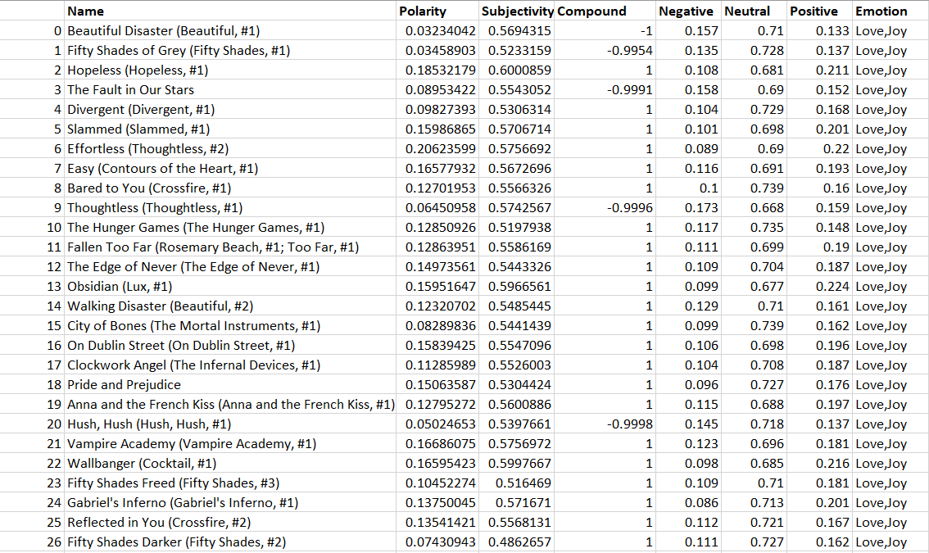
Feature Derivation
Shraddha

Slide 17
Categorizing
Shraddha

Slide 18
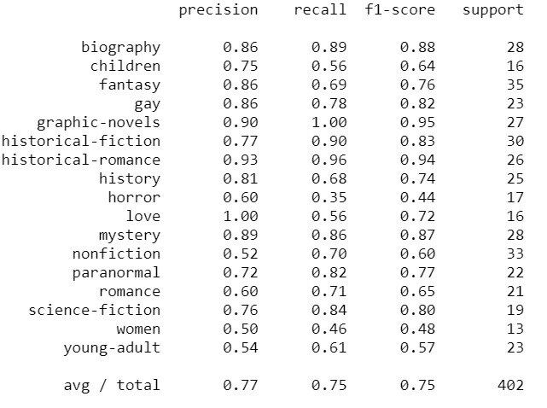
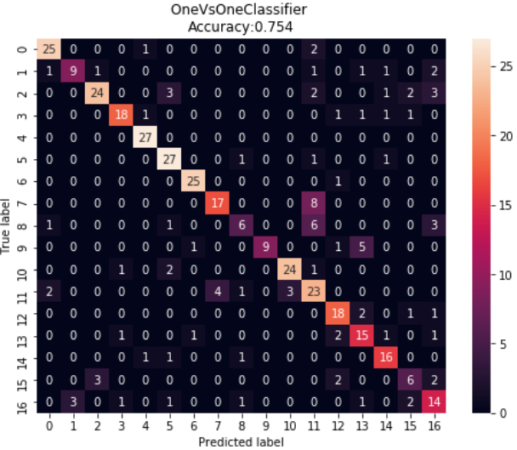
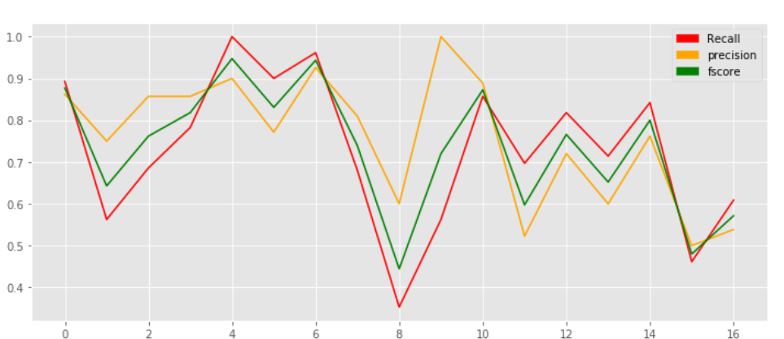
Categorizing
One vs One Classifier
We are categorizing the books based on their tags.
In the one-vs.-one (OvO) reduction, one trains K (K − 1) / 2 binary classifiers for a K-way multiclass problem; each receives the samples of a pair of classes from the original training set, and must learn to distinguish these two classes. At prediction time, a voting scheme is applied: all K (K − 1) / 2 classifiers are applied to an unseen sample and the class that got the highest number of "+1" predictions gets predicted by the combined classifier.
Precision of 77% was achieved when we tried to one vs one classification.
Shraddha

Slide 19
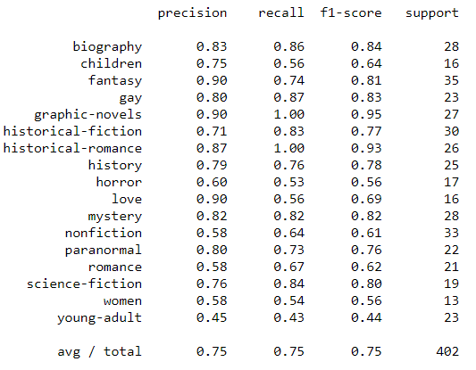
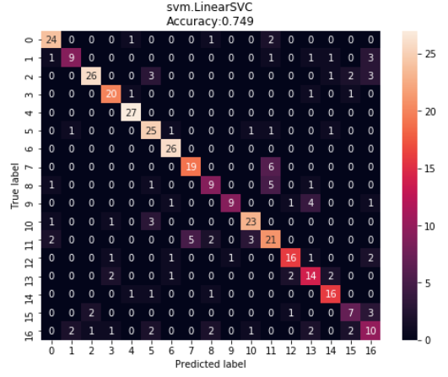
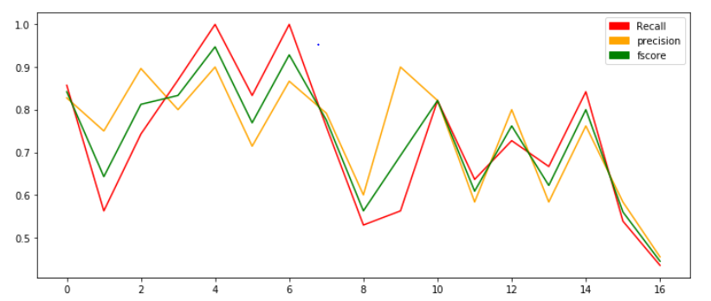
Categorizing
SVM Linear SVC
We are categorizing the books based on their tags.
A regular SVM with default values uses a radial basis function as the SVM kernel. This is basically a Gaussian kernel aka bell-curve. Meaning that the no man's land between different classes is created with a Gaussian function. The linear-SVM uses a linear kernel for the basis function, so you can think of this as a ^ shaped function. It is much less tunable and is basically just a linear interpolation.
Precision of 75% was achieved when we tried to SVM Linear SVC classifier.
Shraddha
Notes:
content based

Slide 20
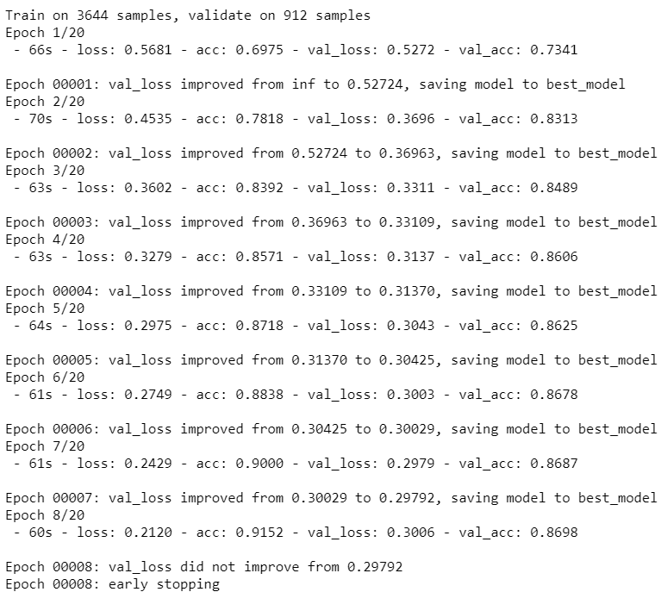
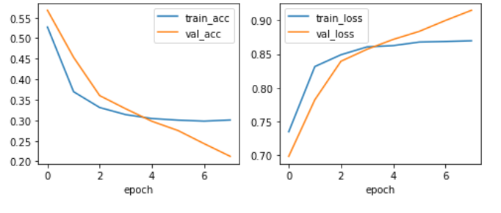
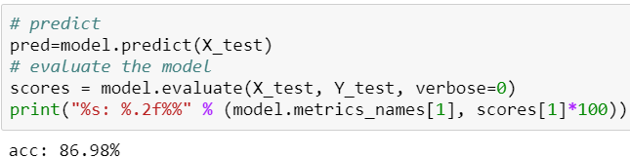
Convolution Neural Network - Deep Learning
Multi Label Classification using CNN - Keras
Keras is an open source neural network library in Python.
Converted each document to a list of word index as a sequence.
Padded all sequences into the same length.
Created a CNN model by altering the filter size, total number of words, max words in the document, vector dimension, drop-out rate, number of units in the dense layer and number of output units.
We compared the performance of our model with and without Pre-trained word of vectors.
Mukunth

Slide 21
Recommendation System

Slide 22
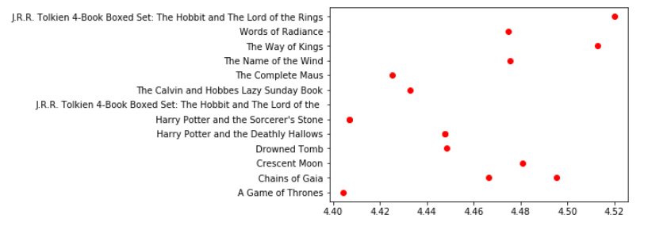
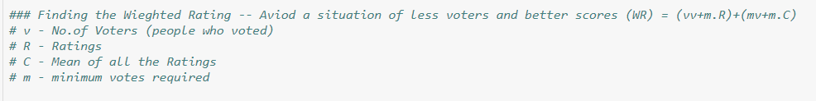
Simple Recommendation System
It is a system that recommends the top Books based on a certain metric.
This metric is used by best recommendation system websites, so we tried implementing it in our systems.
We decided to use the “Weighted Rating method” to calculate the metric.
The metric is derived using the metadata of the books that we scrapped.
The normalizing measure is done to make to make sure that the decision towards recommendation isn’t taken in a biased manner using the ratings alone.
Top 15 Books using metrics
Mukunth

Slide 23
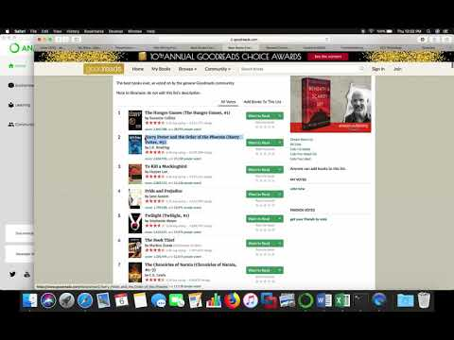
model Comparison
Mukunth
Notes:
content based

Slide 24
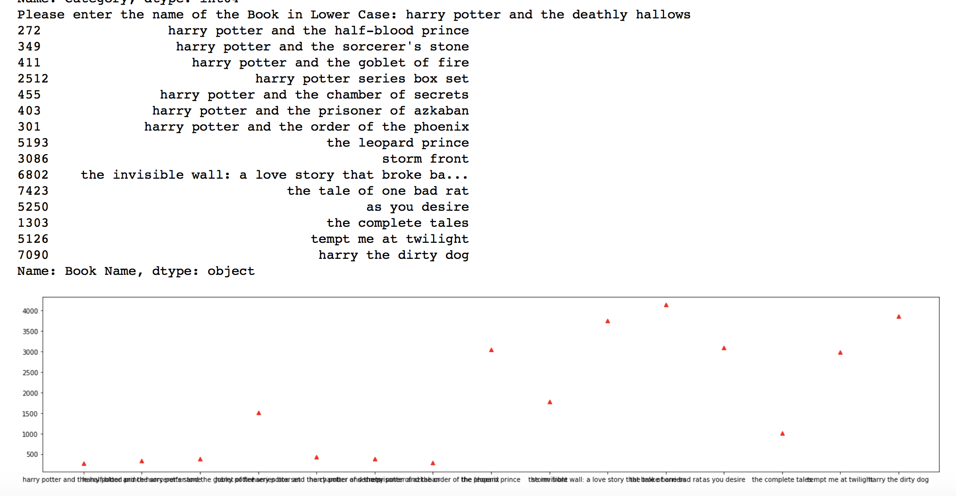
Content Based Recommendation
Building a system to recommend books that are similar to a particular book.
We found the index of the Book given its title.
Got the list of cosine similarity scores for
that particular books fwith all books
and converted it into a list of tuples
where the 1st element is its position and
the 2nd element is the similarity scores.
We computed Pairwise Similarity Scores
for all the books using the cosine similarity
and sorted them based on the scores.
The 9 most similar books are taken
into consideration and recommended to
the users.
Mukunth
Notes:
content based

Slide 25
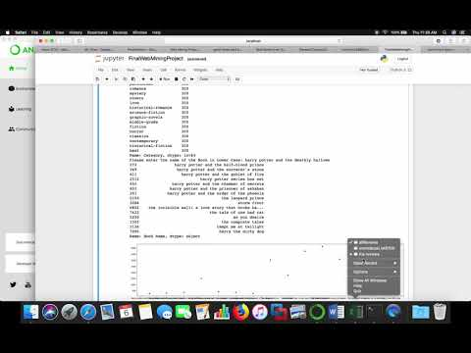
MODEL COMPARISON
Mukunth

Slide 26



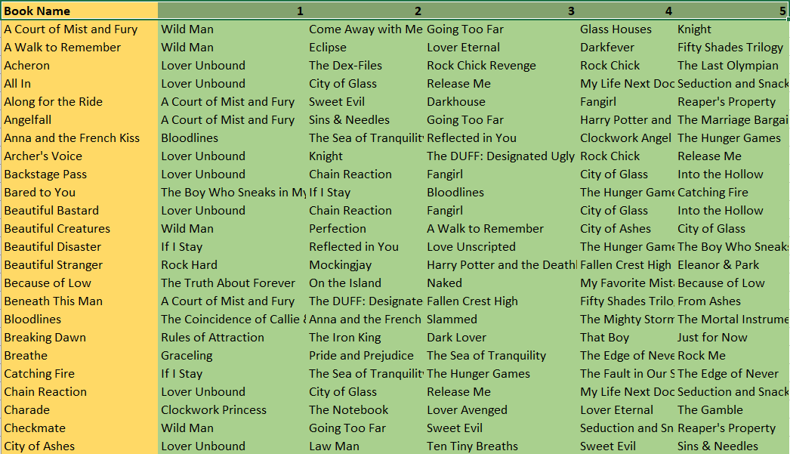
Collaborative Filtering (Item - Item)
A person who liked math book can get bored and start liking other books, but the math book is always similar to other math books.
Recommending Books based on the books you like.
Initially, we build a matrix with a column and a row for each user’s rating and books (Most of the values in this matrix will be ‘Nan’ - Users wouldn’t have read all the books).
We replace those ‘NaN’ values to 0.
Then we calculate the similarity between every books and store those values in a empty Data Frame.
This Data Frame consist of both the column and row names being the ‘Title of the book’.
Intersection of the row and column represents the similarity of the books.
We use Cosine Similarity to find the distance between the books.
Finally, with the cosine distance we are able to find the similar books.
Mukunth
Notes:
content based

Slide 27
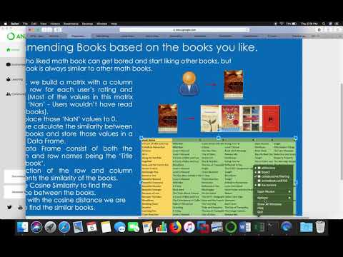
MODEL COMPARISON
Mukunth

Slide 28
Evaluation Barriers
The following factors restrained us from evaluating our results better:
The constriction on the number of books (300) that were scrapped in each category.
Goodreads.com is a dynamic website, recently there was a change in the framework of the website since the time we had scraped the data.
The continuous activity of the users contributing to the change in the reviews and ratings of the book on a day to day basis .
Amey

Slide 29
FUTURE SCOPE
The following is the future scope that we envision to accomplish in streamline of the current progress of the project :
Establish a Chatbot facility for users to interact with the system to have a best recommendation
Throw a recommendation to the user as soon as he hits the first visit of the day -
“Today’s Best read for the day tailored with love and wisdom by goodreads just for you”
Establish a learning pattern for the new users based on a series of questions to make their profile apt for machine learning purposes.
3)
4)
Lastly and most importantly, inject emotions in the operability of Goodreads
Amey

Slide 30
Thank You.
Any Questions ?
We would like to express our deepest gratitude and thankfulness towards Professor Liu for her unparalleled teachings and support throughout the entire project.

